Slide 1
DETAILED PROJECT REPORT-AMAZON SALES DATA ANALYSIS
A.NOORJAHAN

Slide 2
PROJECT DETAILS
PROJECT TITLE | AMAZON SALES DATA ANALYSIS
TECHNOLOGY | BUSINESS INTELLIGENCE
DOMAIN | E-COMMERCE
PROJECT DIFFICULTY LEVEL | ADVANCED
TOOLS USED | JUPYTER, POWER BI,PANDAS,SEABORN,MATPLOTLIB
RESOURCES | Dataset: https://drive.google.com/drive/folders/1FkmFVL8wlJmQWP1z52TD8PlhOJhitTyI?usp=s haring

Slide 3
PROBLEM STATEMENT
Sales management has gained importance to meet increasing competition and the need for improved distribution methods to reduce cost and increase profits.
Today, sales management is the most important function in a commercial and business enterprise.
Find key metrics and factors and show the meaningful relationships between attributes

Slide 4
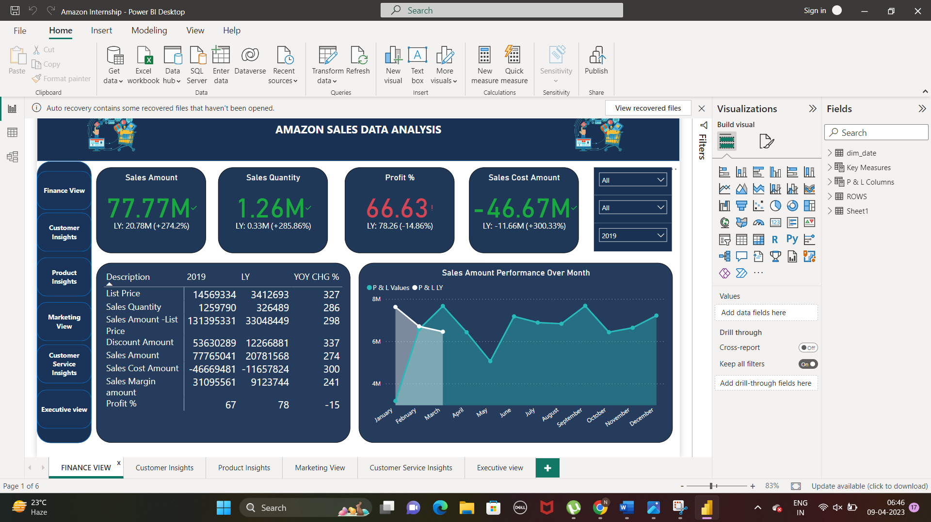
FINANCE VIEW
In 2019, the sales amount is increased more than 274% but, that abrupt increase is due to the less sales for just 3 months in 2018.

Slide 5
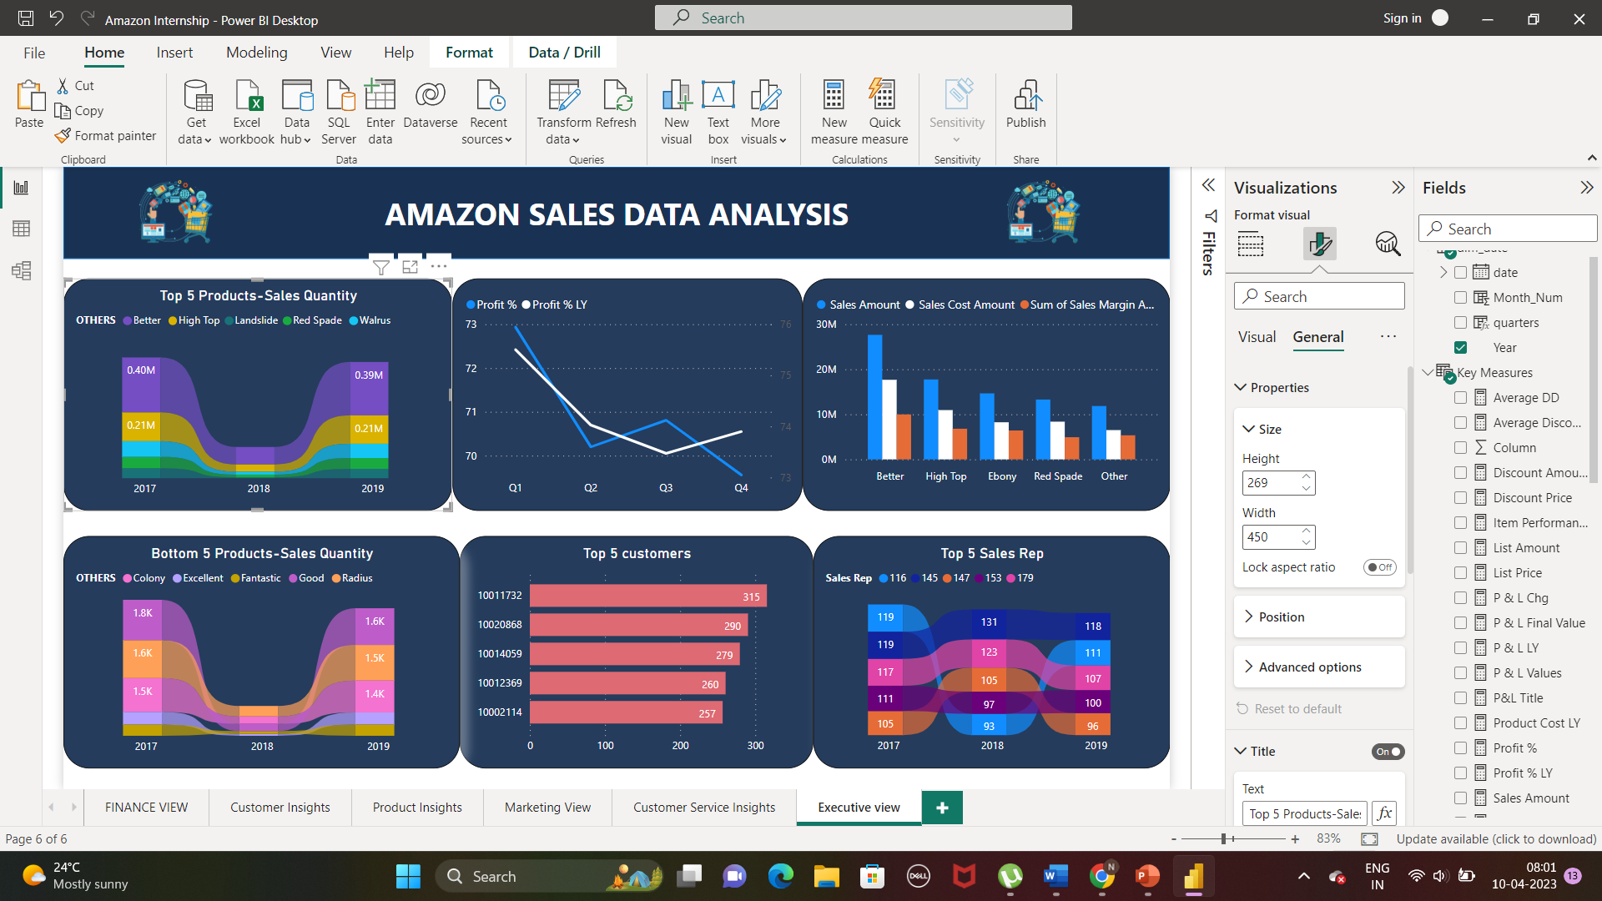
EXECUTIVE VIEW
We can see the improvement of sales rep 116 from 2018 to 2019, though he/ she dipped from 2017 to 2018
Sales cost amount of better, high top, red spade is more because of is more quantity of product manufactured.
But when we see the ebony, though it is among top three in sales cost amount it not in top 5 list. i.e. it is giving is less profit and more loss, because of giving of more discount amount
Landslide is topped 3 but it is giving more profit due to less sales cost amount of less than 5M

Slide 6
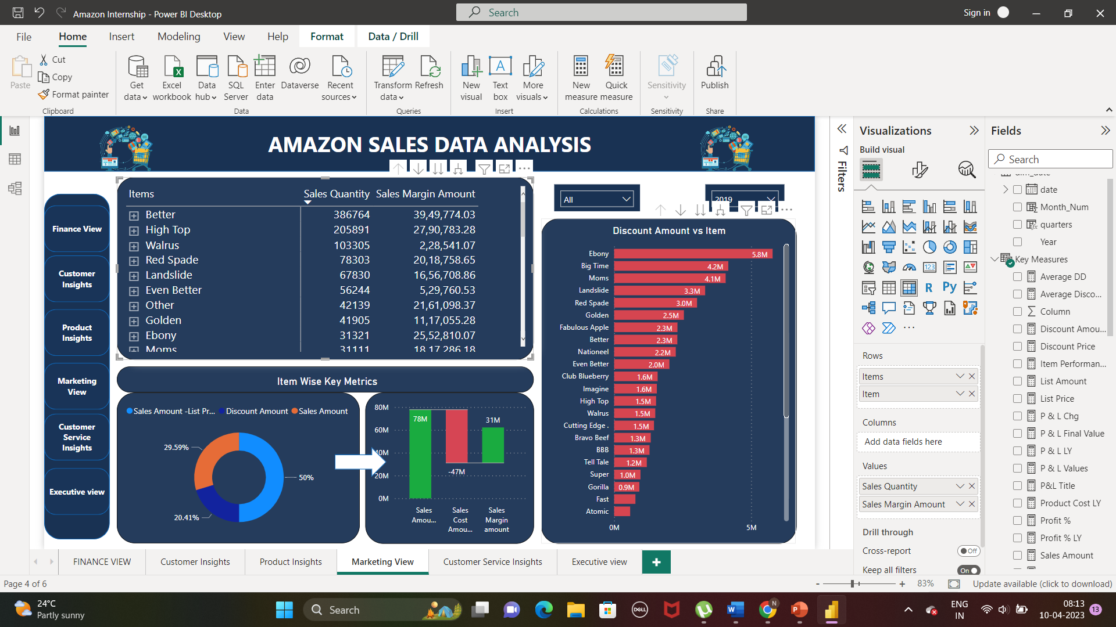
MARKETING VIEW
Discount Amount is giving moderate impact on sales quantity , as ebony is getting more discount amount, but the sales quantity is less
But Better is just getting 2.3 M discount when compared with ebony it is topped in sales quantity more than 3M
Fantastic is lowest sales Quantity, because of its less discount amount.

Slide 7
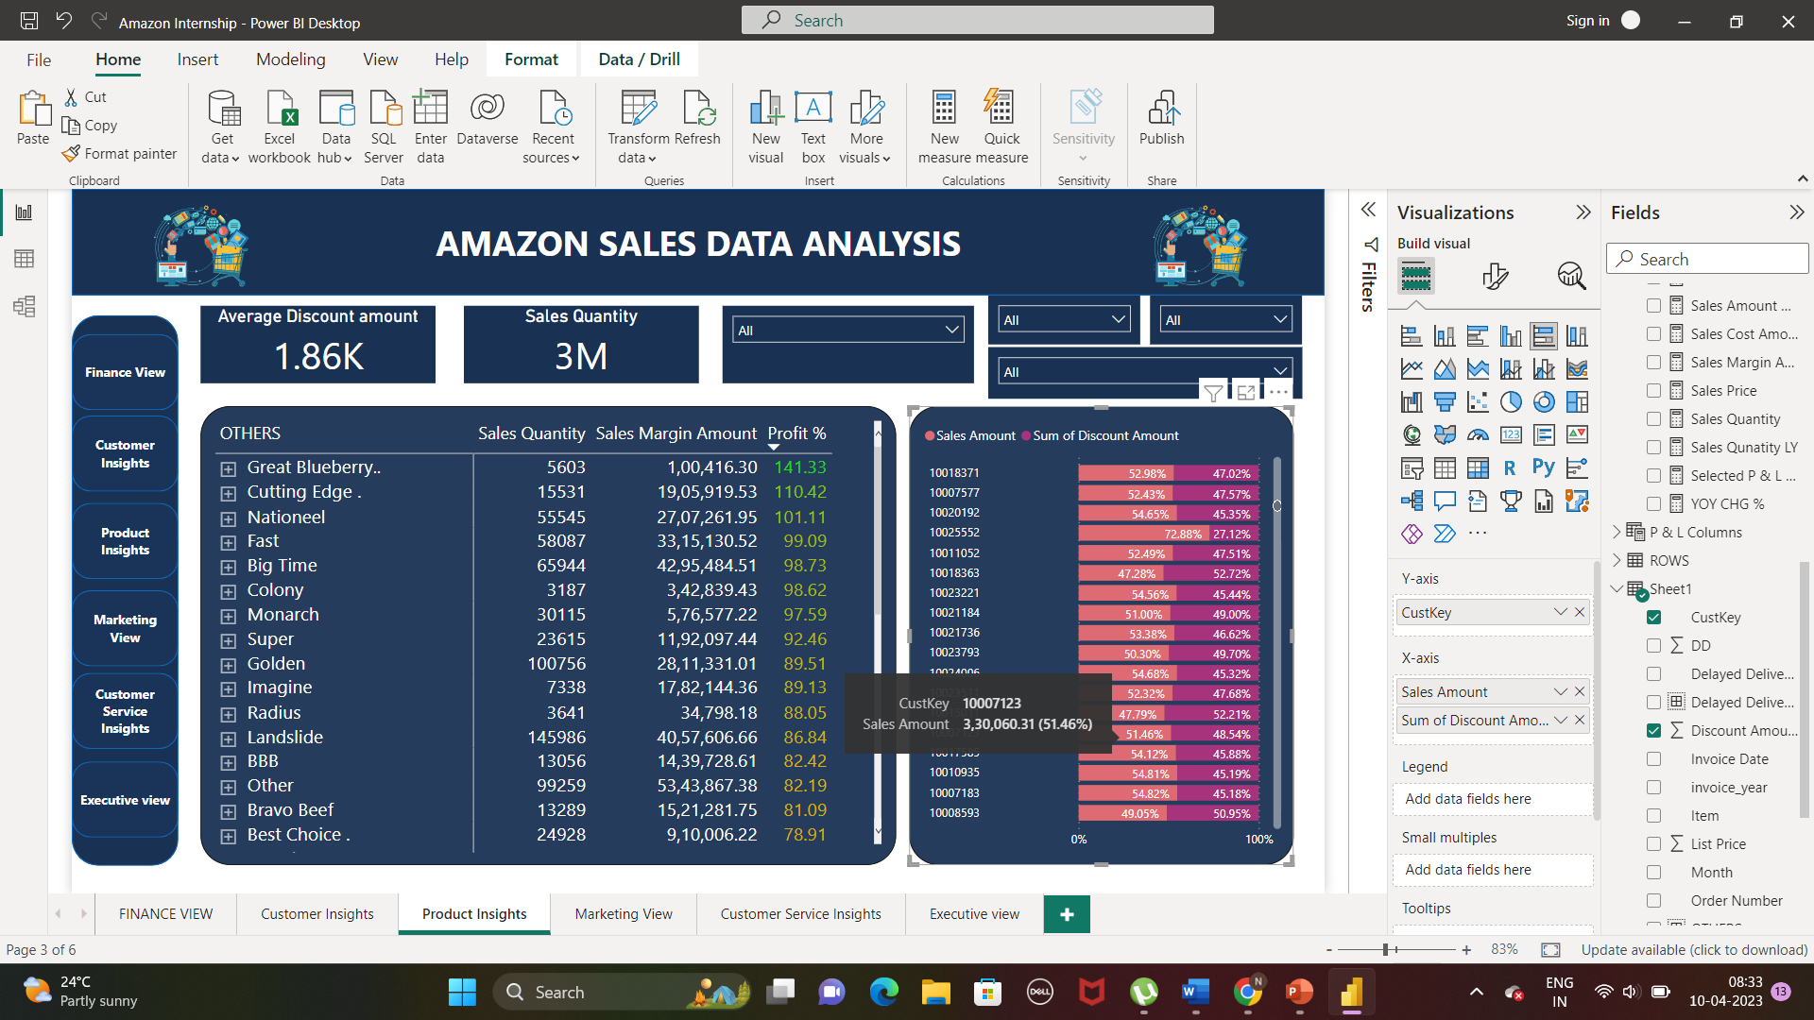

Slide 8
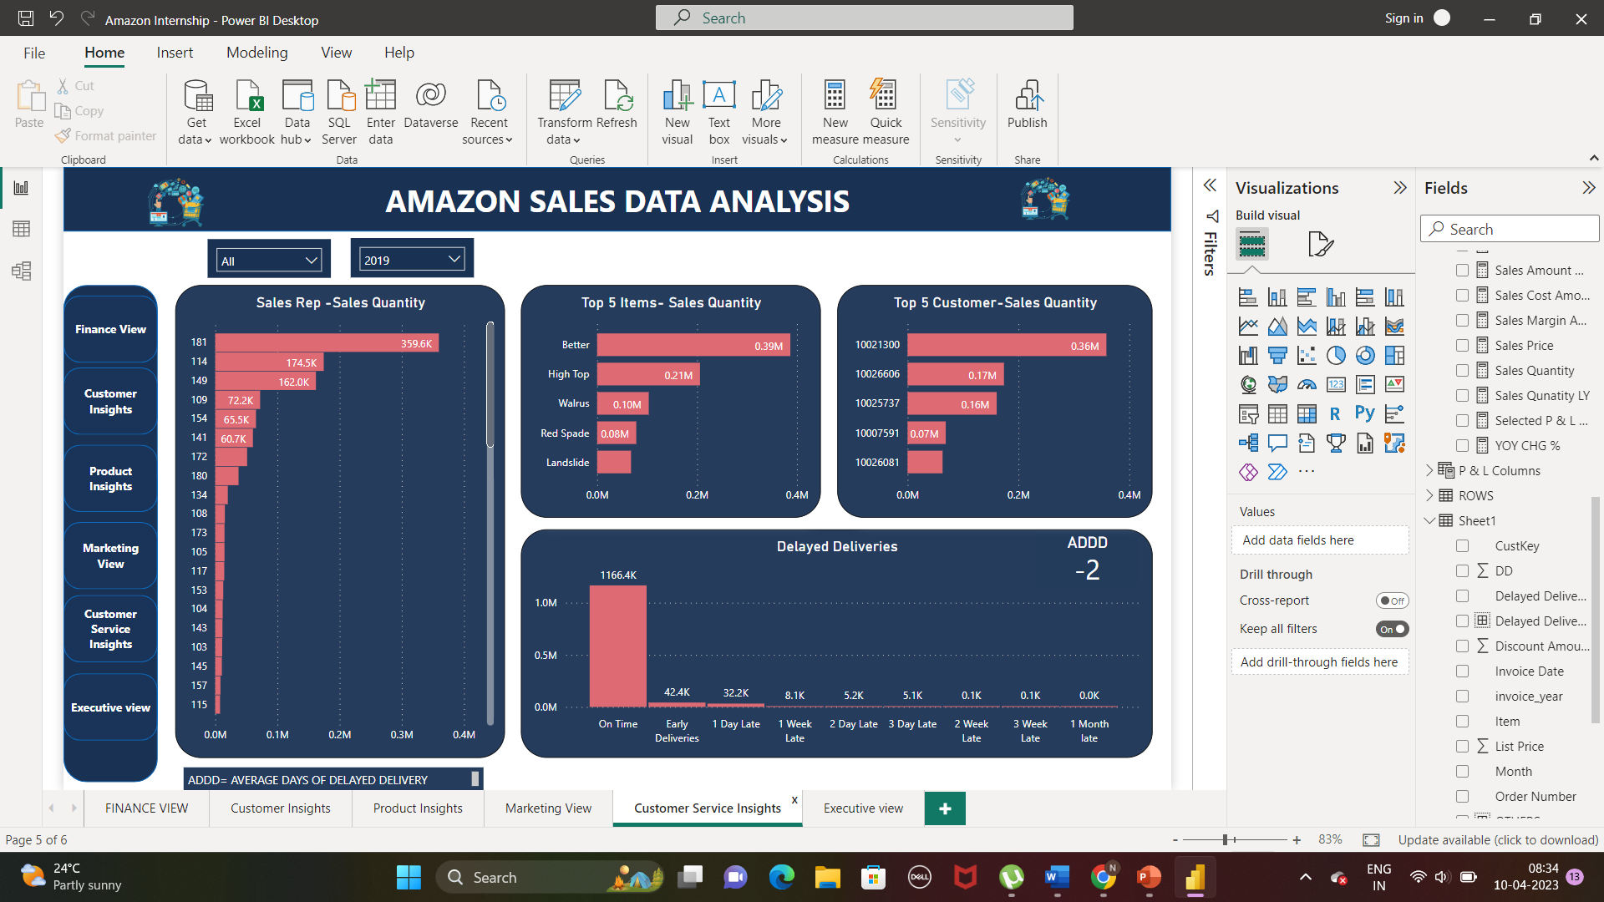
CUSTOMER SERVICE INSIGHTS
Though , most deliveries on time, about 2 days delayed delivery on a average of total deliveries. Sales Rep 181 is performing well in sales quantity and early deliveries; sales rep 162 is common among the most delayed delivery

Slide 9
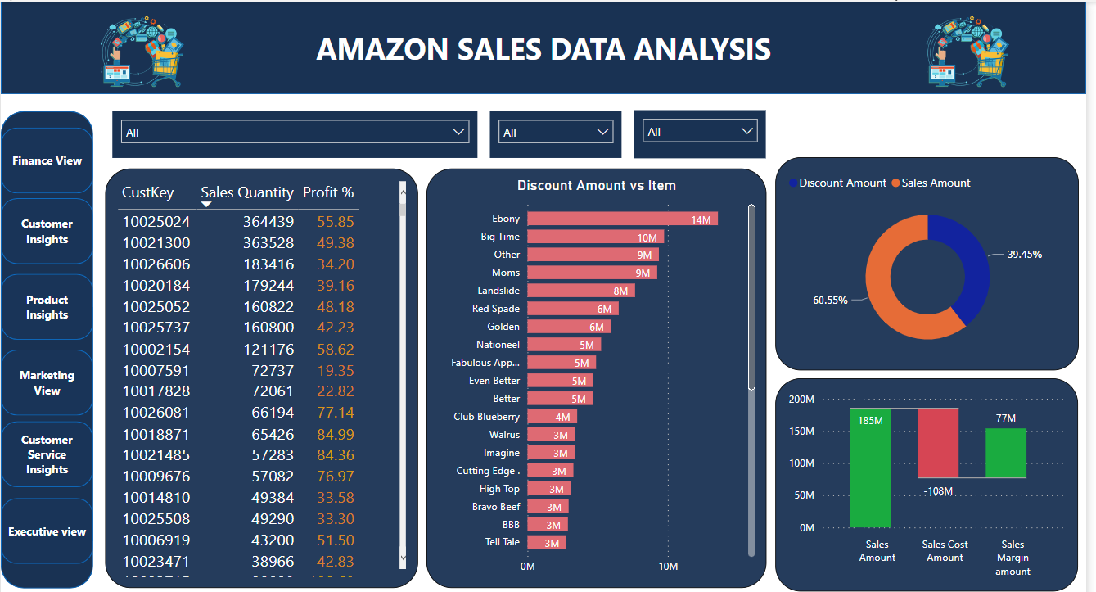
PRODUCT INSIGHTS
Customer 100025024 is topped with moderate profit percentage, overall their discount amount is also the least one.

